Slide 1
CSCI 566: Deep Learning and Its Applications
Jesse Thomason
Lecture 8: Multimodal Deep Learning

Slide 2
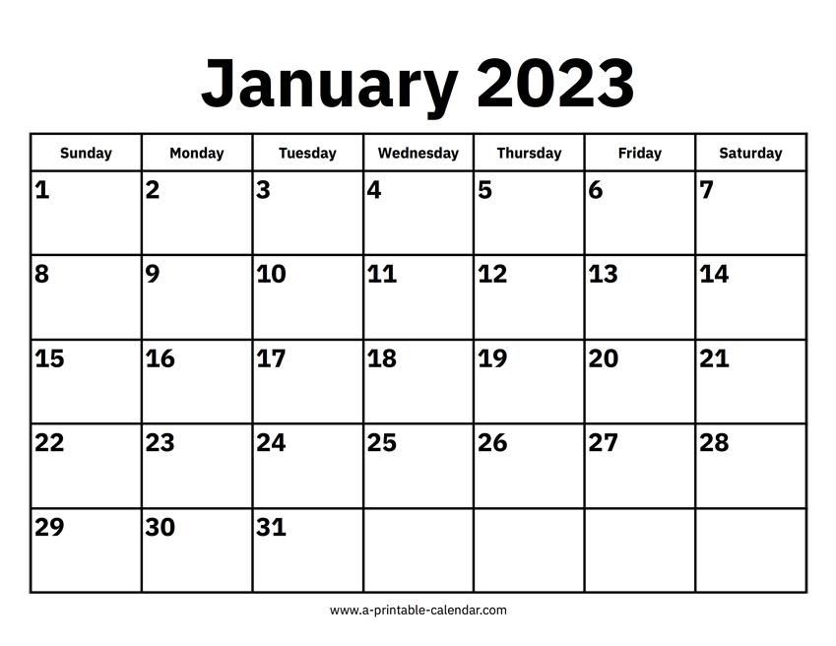
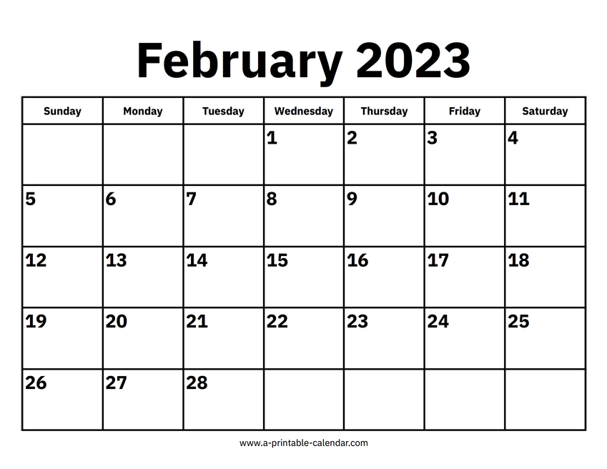
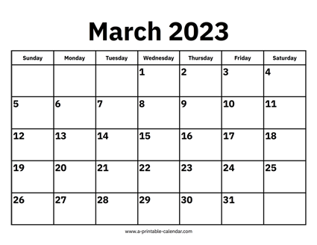
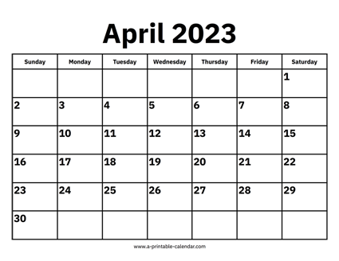


CSCI 566 Roadmap
Module 1: Neural Network Basics
Module 2: Deep Learning Applications
Module 3: Advanced Topics in Deep Learning

Slide 3
[Mar 24] Endgame Deliverables
Assignment 2 Due | Mar 31
Project Midterm Report | Mar 31
Paper Roleplaying Breakout Sessions | Mar 31, April 7, April 14
Final Project Presentations | April 21, April 28
Project Final Report | May 3

Slide 4
Project Midterm Reports Due Mar 31st, 11:59pm
Details about the set of initial experiments you have done for the project
Can involve a short abstract/introduction
Should involve reproducing the results of a state-of-the-art baseline model for the task of interest with code that you have implemented, or a pilot version of your proposed approach
Talk about the specific dataset(s) you choose to use, the evaluation protocol and metric you decide to have, and the experiment settings.
Perform an analysis of what remaining errors your mid-report model makes and describe how you will approach these by the final report
Format: a 3-page report + contributions page
Syllabus provides suggested format outline and grading breakdown

Slide 5
Paper Roleplaying Breakouts: March 31, April 7, April 14
On these days, we will have ~90 minutes of lecture followed by ~90 minutes for paper roleplaying breakout sessions
Upshot: You will take on a “role” that defines your relationship with a paper to be discussed
You will deep dive into the paper with respect to your role
You will produce a 2 page document + participate in the detailed, 90-minute discussion with your breakout group
You are expected to play one role for one session across these three days; you’re free to participate as an observer on days for which you are not scheduled to be in a session

Slide 6

Paper Roleplaying Breakouts: March 31, April 7, April 14

Slide 7
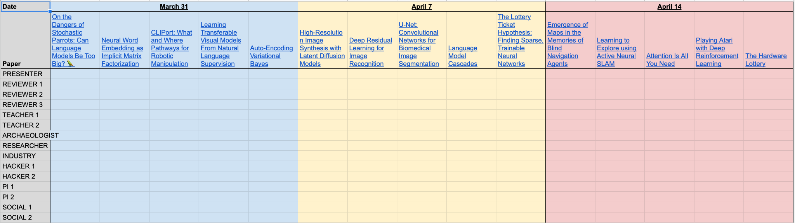
Paper Roleplaying Breakouts: March 31, April 7, April 14
Self sign-up; don’t overwrite or move other people!
Self sign-up sheet

Slide 8
Project Final Presentations: April 21, April 28
Note that project final presentations will take place over two different classes [team sign up sheet]
You should sign up your team for a slot on one of these days
We will discuss further details about what should be contained in the final talk closer to the due dates; you will be expected to attend these final presentations
Your group will submit to us a multiple choice question about your final presentation, which we’ll use to build quizzes that summarize each day’s presentations.

Slide 9
Overview of Today’s Plan
Course organization and deliverables
Any questions before we move on?
Lecture 7 Recap
Multimodal Deep Learning

Slide 10
Autoencoder
That word embeddings are a learned compression of co-occurrence matrices for tokens is part of a larger trend
One can formulate deep learning models to be learned compression algorithms for a given input space
Autoencoding is unsupervised:
Given input of size X, shrink to size x<X with learned function (encoder) and unshrink it back to X with a another learned function (decoder)
Autoencoders learn a lower dimensional manifold for input

Slide 11
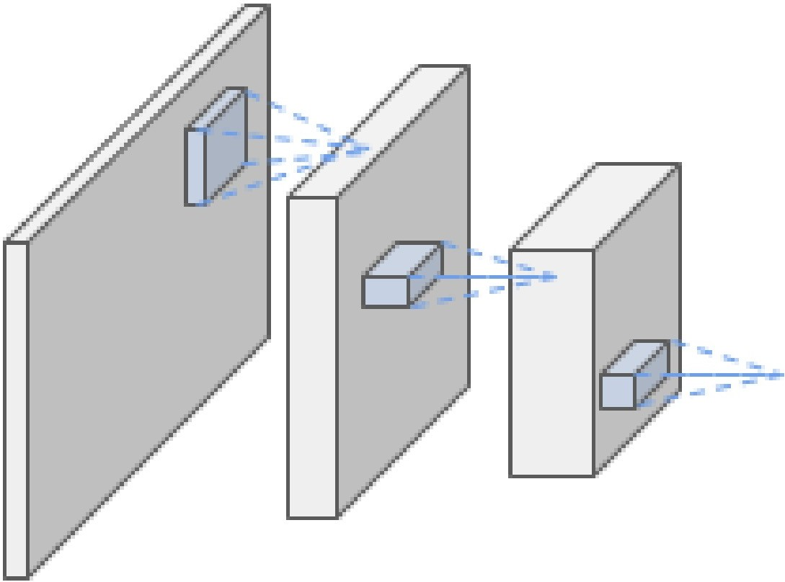
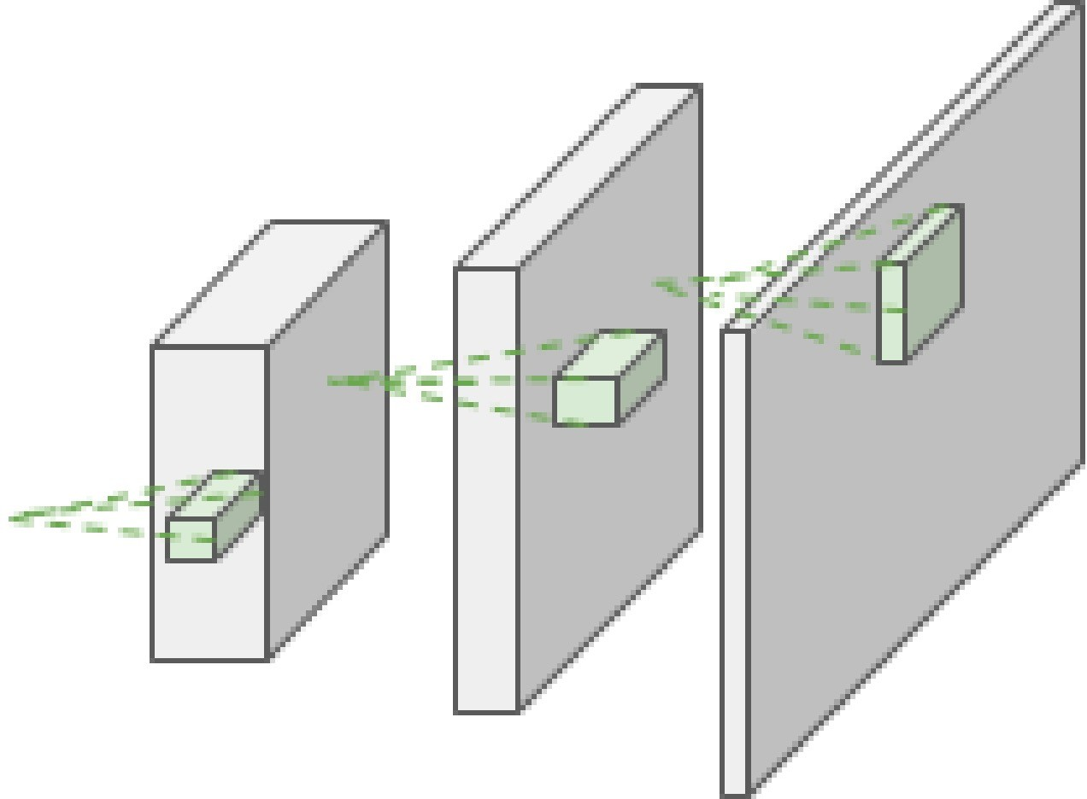
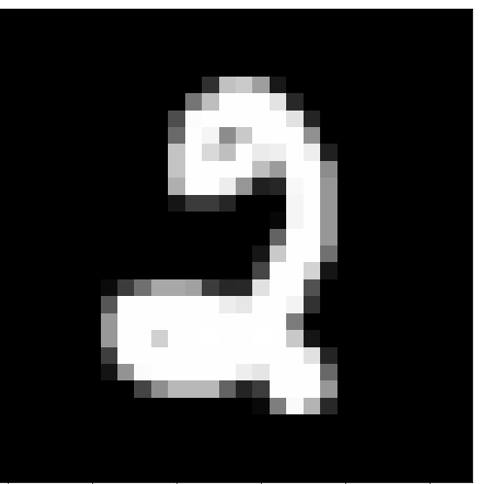
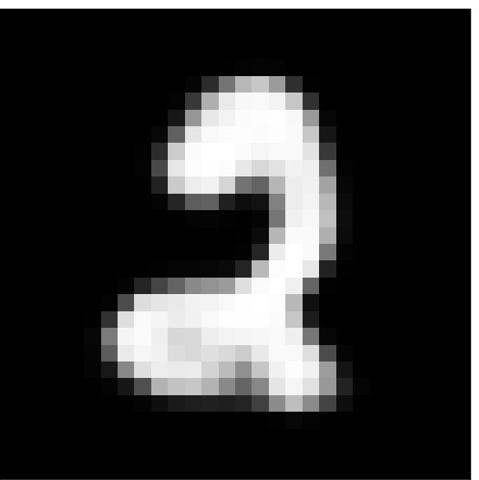

CNN Autoencoder
Reconstruction Loss L(x, x’)
Input x
Encoder
f_{e}(x;θ_{e})=z
Latent z
Decoder
f_{d}(z;θ_{d})=x’
Reconstructed input x’

Slide 12
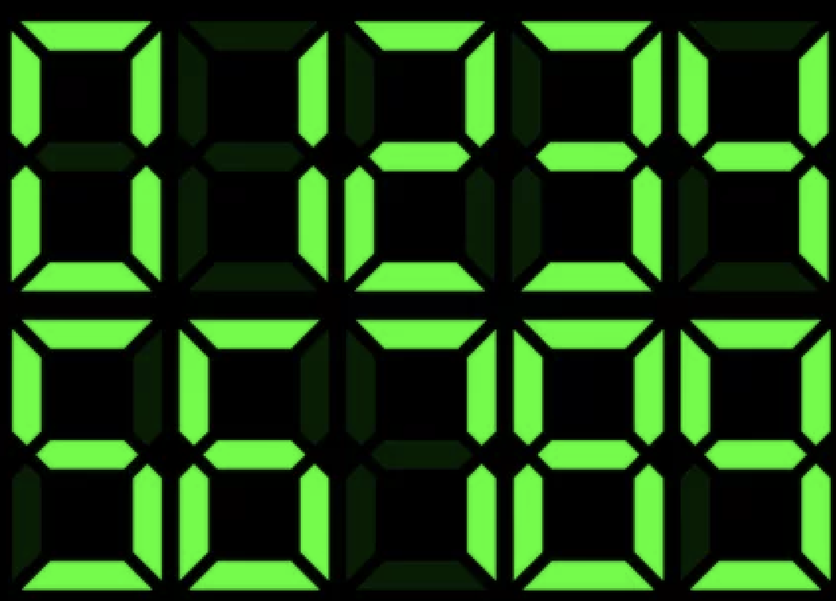
What Might The Latent Space “Look Like”?
Let’s imagine for ourselves: you are compressing digits and using a cross-entropy loss (rather than MSE) to judge whether the reconstructions are accurately classified as class 0…9
Let’s say the latent space is a single, binary vector of dimension seven
What representation could emerge?

Slide 13
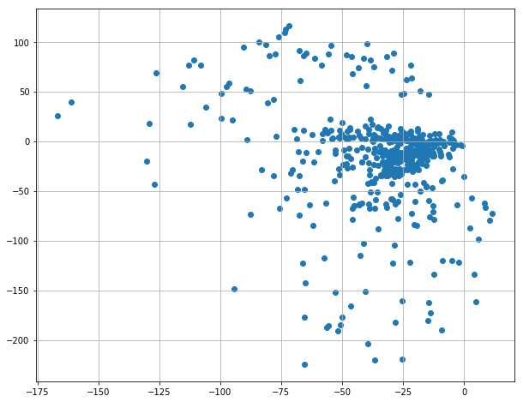

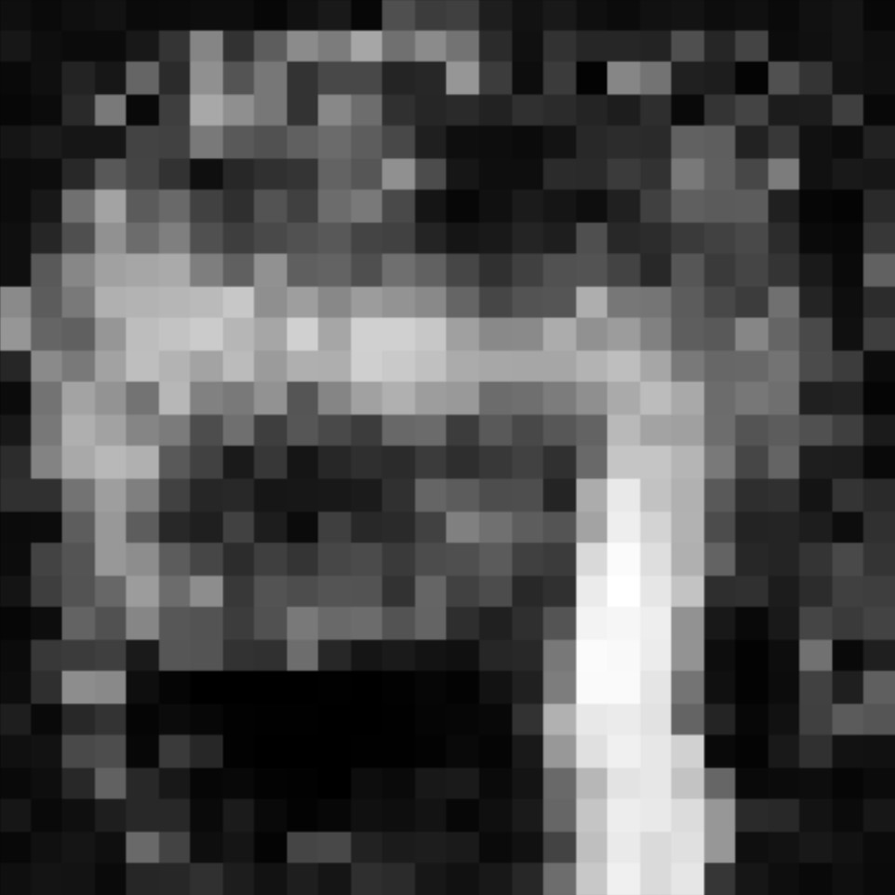
Autoencoder Decoder As Data Generator
Manifold X:
Sampled z’
Sampled z’
What if we sample vector z’ as draws from a Gaussian?
Will we achieve reconstructions that look like our input data X?
No! Our data X encodes to a particular manifold in R^{|z|}

Slide 14
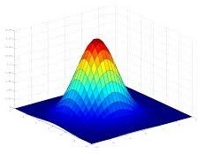
Variational Autoencoder
Latent Space Loss L_{G}(z_{μ}, z_{𝜎})
Reconstruction Loss L_{R}(x, x’)
Latent z_{μ}
Latent z_{𝜎}
Input x
Encoder
f_{e}(x;θ_{e})=(z_{μ}, z_{𝜎})
Decoder
f_{d}(z_{μ}+εz_{𝜎};θ_{d})=x’
Reconstructed input x’
We learn a mean and variance for the latent manifold for every input, then constrain those to be Gaussian

Slide 15
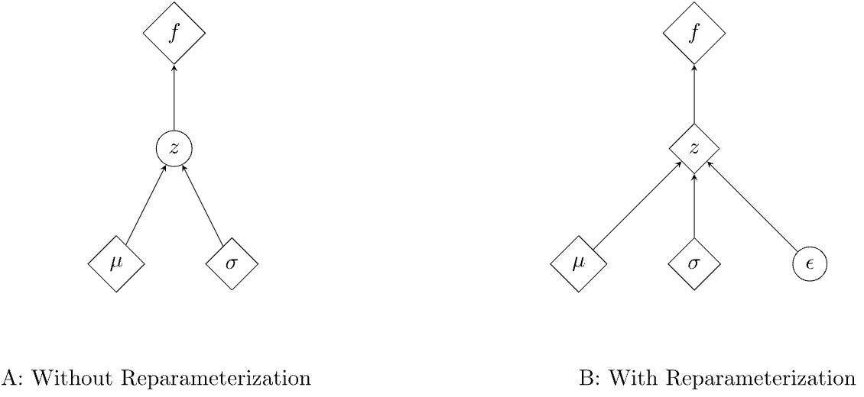
Variational Autoencoder
Latent Space Loss L_{G}(z_{μ}, z_{𝜎})
Reconstruction Loss L_{R}(x, x’)
Latent z_{μ}
Input x
Latent z_{𝜎}
ε
Encoder
f_{e}(x;θ_{e})=(z_{μ}, z_{𝜎})
Decoder
f_{d}(z_{μ}+εz_{𝜎};θ_{d})=x’
Reconstructed input x’
Input ε~N(0,1)
The Reparameterization Trick in Variational Autoencoders

Slide 16
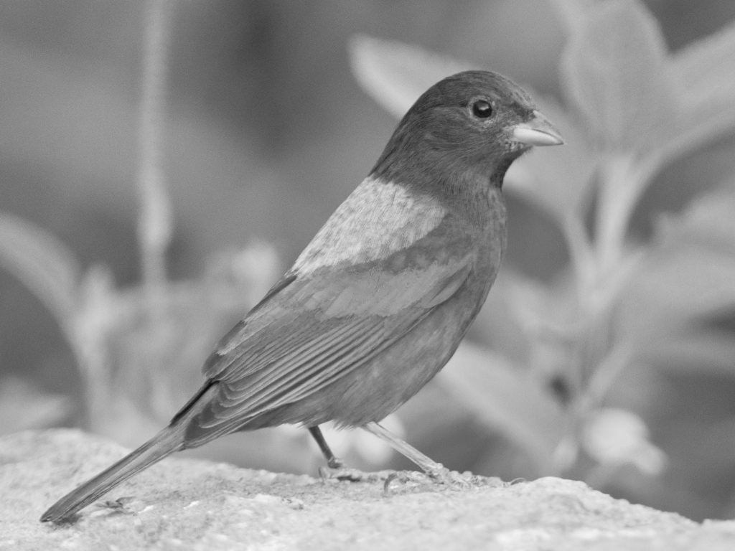
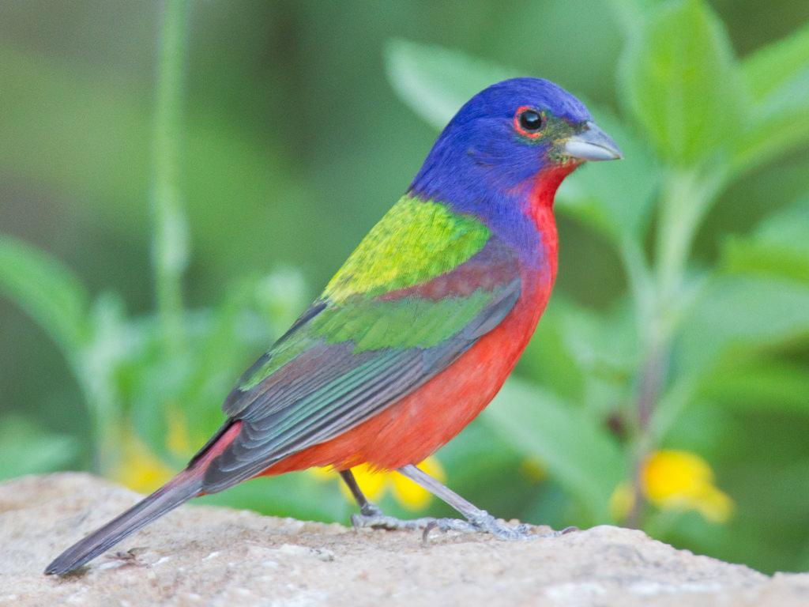
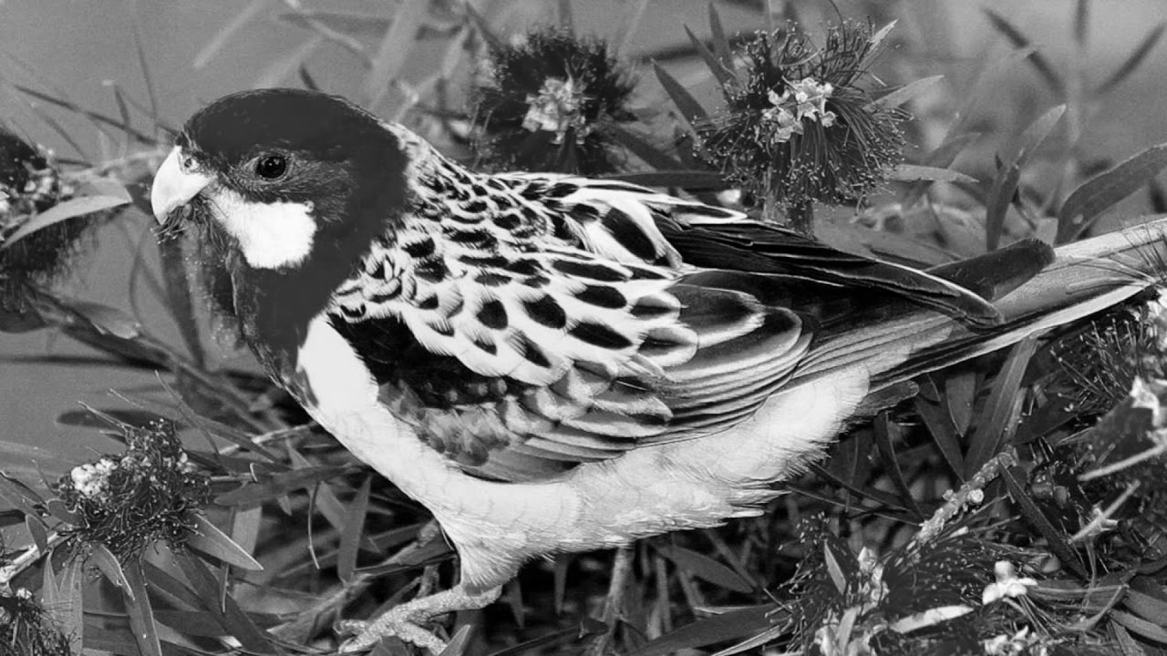
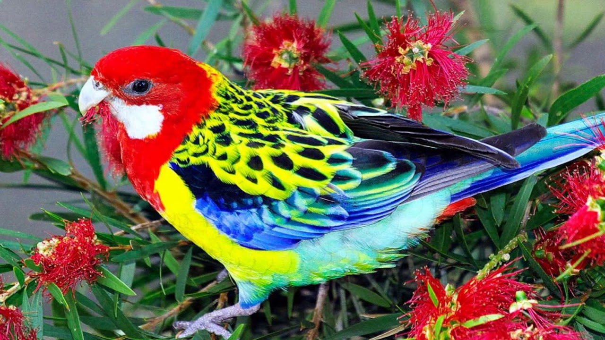
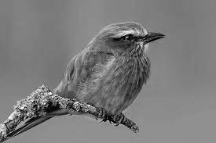
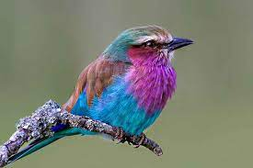
Autoencoder Decoder For Downstream Tasks

Slide 17
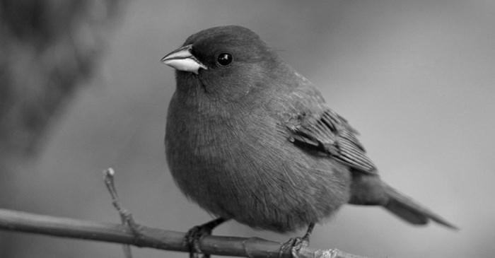
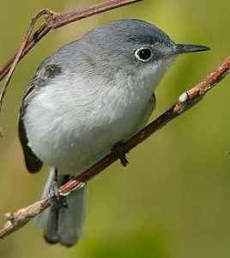
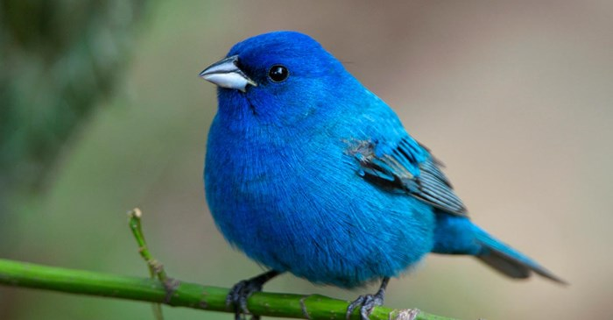
Variational Autoencoder Mode Collapse
Minimizing reconstruction loss means defaulting to averages for high variance tasks like “coloring a bird”
Average minimizes the loss but never gets the right color!
How can we penalize taking these “safe bet” local minima?

Slide 18
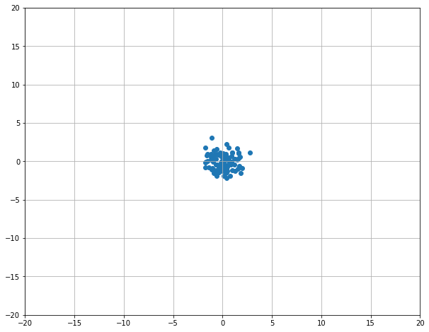
Generative Adversarial Networks
D(·)=1
D(·)=1
D(·)=0
D(·)=1
Rand N(0, 1)
Generator f(z) -> x’
Generator Network
Gen Images
Train Images
Rand z
Decoder
f_{d}(z;θ_{d})=x’
Upsampled x’
Discriminator D(x’) -> 0
Discriminator D(x) -> 1
Discriminator Network D
Discriminator Network D
Real/Fake Decision
Real/Fake Decision

Slide 19
Transformers
Transformer T : S_{a} ⟶ S_{b} is a function from…
A set a in S_{a} to a set b in S_{b}
Simple transformer consists of a single layer encoder E and a single layer decoder D with single-headed attention

Slide 20

Transformers: Self-attention
FF
FF
FF
FF
Self Attention
Attention Is All You Need

Slide 21
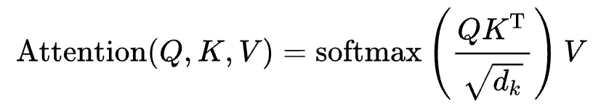
Scaled dot-product attention
FF
FF
FF
FF
Self Attention
Our input for self-attention is the matrix X which is the embeddings of the input sequence
So we call Attention(X, X, X)

Slide 22
Self-Attention
FF
FF
FF
FF
∈R
∈R
Self Attention
q₁
k₁
v₁
k₂
v₂
W_{Q}
W_{K}
W_{V}
W_{K}
W_{V}
X
x₁
x₁
x₁
x₂
x₂

Slide 23
Self-Attention
…
e
e
e
Σ
e
Σ
e
Σ
e
∈R
∈R
∈R
q₁
k₁
v₁
k₂
v₂
k₃
v₃
…
W_{Q}
W_{K}
W_{V}
W_{K}
W_{V}
W_{K}
W_{V}
x₁
x₁
x₁
x₂
x₂
x₃
x₃

Slide 24
Self-Attention
a₁
…
e
e
e
Σ
e
Σ
e
Σ
e
∈R
∈R
∈R
q₁
k₁
v₁
k₂
v₂
k₃
v₃
…
W_{Q}
W_{K}
W_{V}
W_{K}
W_{V}
W_{K}
W_{V}
x₁
x₁
x₁
x₂
x₂
x₃
x₃

Slide 25
Self-Attention
a₁
a₂
…
e
e
e
Σ
e
Σ
e
Σ
e
∈R
∈R
∈R
k₁
v₁
q₂
k₂
v₂
k₃
v₃
…
W_{K}
W_{V}
W_{Q}
W_{K}
W_{V}
W_{K}
W_{V}
x₁
x₁
x₂
x₂
x₂
x₃
x₃

Slide 26
Self-Attention
…
a₁
a₂
a₃
…
e
e
e
Σ
e
Σ
e
Σ
e
∈R
∈R
∈R
k₁
v₁
k₂
v₂
q₃
k₃
v₃
…
W_{K}
W_{V}
W_{K}
W_{V}
W_{Q}
W_{K}
W_{V}
x₁
x₁
x₂
x₂
x₃
x₃
x₃

Slide 27
Encoder-Decoder Attention
FF
FF
FF
FF
a₁
a₂
a₃
a₄
Attention(D, E, E)
Enc-Dec Attention
Attention(X_{d}, X_{d}, X_{d})
d_{1,1}
e₁
Self Attention
Attention Is All You Need

Slide 28
Deeper Encoders / Decoders
FF
FF
FF
FF
{1, 2, 3, 4}
FF
FF
FF
FF
Enc-Dec Attention
Decoder
Self Attention
Self Attention
FF
FF
FF
FF
FF
FF
FF
FF
Encoder
Enc-Dec Attention
Self Attention
Self Attention
{a, b, c, d}

Slide 29
Supervision: Masking
{1, 2, 3, 4}
Loss
{1, 2, ∅, 4}
Decoder
Encoder
{a, b, c, d}

Slide 30
Sequences
[1, 2, 3, 4]
What if we want our input/output to be sequences?
E.g., sentences!
Prev:
{a, c, d} -> {4, 3, 1},
Want:
[a, c, d] -> [1, 3, 4]
Decoder
Encoder
[i1, i2, i3, i4]
[a, b, c, d]

Slide 31
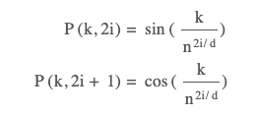
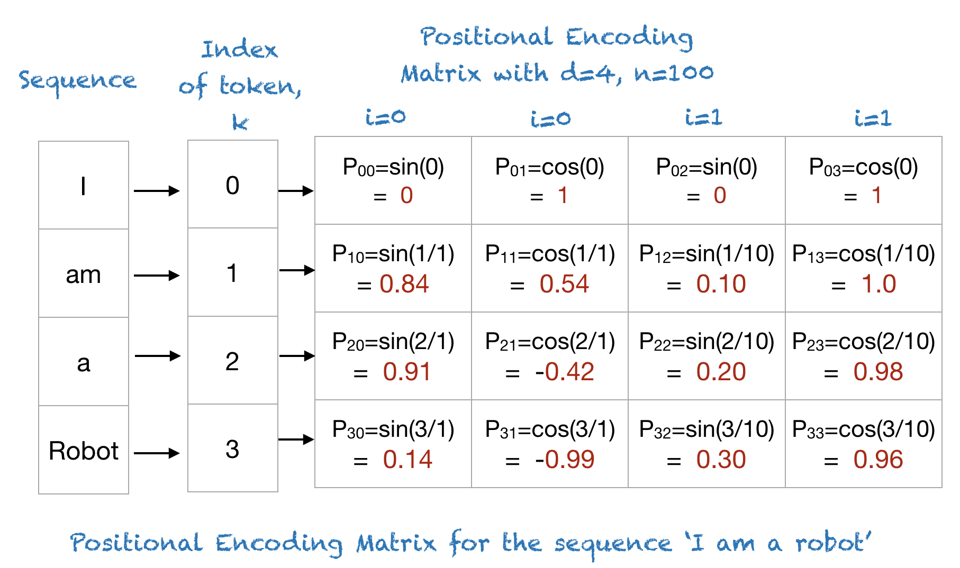
Sequences: What is a Positional Encoding?
[1, 2, 3, 4]
Creating a consistent “indicator vector” for each position
“Nearness” between adjacent positions preserved by encoding functions.
Decoder
cos(p(0), p(1)) = 0.77
Encoder
cos(p(0), p(2)) = 0.28
cos(p(1), p(2)) = 0.77
cos(p(0), p(3)) = -0.01
cos(p(1), p(3)) = 0.28
cos(p(2), p(3)) = 0.77
[i1, i2, i3, i4]
[a, b, c, d]
https://machinelearningmastery.com/a-gentle-introduction-to-positional-encoding-in-transformer-models-part-1/

Slide 32
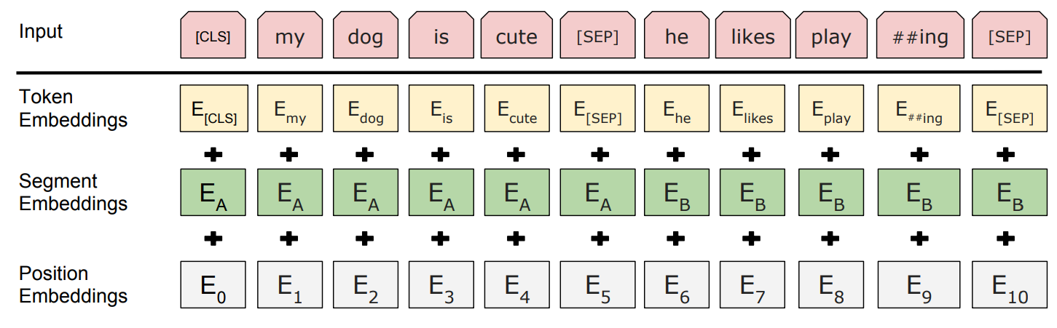
Bidirectional Encoder Representations from Transformers
BERT: Pre-training of Deep Bidirectional Transformers for Language Understanding

Slide 33
Masked Language Modeling Pretraining
15% of words selected for training
[MASK]
PEEL
[MASK]
PLAY
80% of those [MASK]
10% random token
10% original token
BERT: Pre-training of Deep Bidirectional Transformers for Language Understanding

Slide 34
Masked Language Modeling Pretraining
dog
cute
he
play
FC+softmax
FC+softmax
FC+softmax
FC+softmax
Transformer w Self-Attention
…
Transformer w Self-Attention
Embedding Layer [Token, Position]
[CLS]
my
dog
is
cute
[SEP]
[MASK]
PLAY
[MASK]
PEEL
he
likes
play
##ing
##le
[SEP]
BERT: Pre-training of Deep Bidirectional Transformers for Language Understanding

Slide 35
Masked Language Modeling Pretraining
Next Sentence Follows?
dog
cute
he
play
FC+softmax₂
FC+softmax
FC+softmax
FC+softmax
FC+softmax
Transformer w Self-Attention
…
Transformer w Self-Attention
Embedding Layer [Token, Position]
[CLS]
my
dog
is
cute
[SEP]
[MASK]
PLAY
[MASK]
PEEL
he
likes
play
##ing
##le
[SEP]
BERT: Pre-training of Deep Bidirectional Transformers for Language Understanding

Slide 36
Sequence-to-Sequence Transformer
893
شجرتان
shajaratan
s(a₂)
A
Enc-Dec Attention [Attn(D, E, E)]
E
D
Self-Attention [Attn(V_{e}(T), V_{e}(T), V_{e}(T))]
Self-Attention [Attn(V_{d}(T’), V_{d}(T’), V_{d}(T’))]
Embedding Layer V_{e}(t) + P(t)
Embedding Layer V_{d}(t’) + P(t)
999
128
137
783
998
999
0
0
0
0
T
<S>
two
trees
sway
<E>
T’
<S>
∅
∅
∅
∅

Slide 37
Sequence-to-Sequence Transformer
489
تتمايلان
tatamayalan
s(a₃)
A
Enc-Dec Attention [Attn(D, E, E)]
E
D
Self-Attention [Attn(V_{e}(T), V_{e}(T), V_{e}(T))]
Self-Attention [Attn(V_{d}(T’), V_{d}(T’), V_{d}(T’))]
Embedding Layer V_{e}(t) + P(t)
Embedding Layer V_{d}(t’) + P(t)
999
128
137
783
998
999
893
0
0
0
T
<S>
two
trees
sway
<E>
T’
<S>
شجرتان
shajaratan
∅
∅
∅

Slide 38
Sequence-to-Sequence Transformer
998
<E>
s(a₄)
A
Enc-Dec Attention [Attn(D, E, E)]
E
D
Self-Attention [Attn(V_{e}(T), V_{e}(T), V_{e}(T))]
Self-Attention [Attn(V_{d}(T’), V_{d}(T’), V_{d}(T’))]
Embedding Layer V_{e}(t) + P(t)
Embedding Layer V_{d}(t’) + P(t)
999
128
137
783
998
999
893
489
0
0
T
<S>
two
trees
sway
<E>
T’
<S>
شجرتان
shajaratan
تتمايلان
tatamayalan
∅
∅

Slide 39
Sequence-to-Sequence Transformer
893
489
998
A
شجرتان
shajaratan
تتمايلان
tatamayalan
<E>
Enc-Dec Attention [Attn(D, E, E)]
E
D
Self-Attention [Attn(V_{e}(T), V_{e}(T), V_{e}(T))]
Self-Attention [Attn(V_{d}(T’), V_{d}(T’), V_{d}(T’))]
Embedding Layer V_{e}(t) + P(t)
Embedding Layer V_{d}(t’) + P(t)
999
128
137
783
998
999
893
489
0
0
T
<S>
two
trees
sway
<E>
T’
<S>
شجرتان
shajaratan
تتمايلان
tatamayalan
∅
∅

Slide 40
Transformers: The Future of the Present
Transformers seem like they might be the universal encoders we’ve been waiting for in multimodal space
Language tokens, image regions, image patches, audio snippets, joint positions, transformers don’t care!

Slide 41
Overview of Today’s Plan
Course organization and deliverables
Lecture 7 Recap
Any questions before we move on?
Multimodal Deep Learning

Slide 42

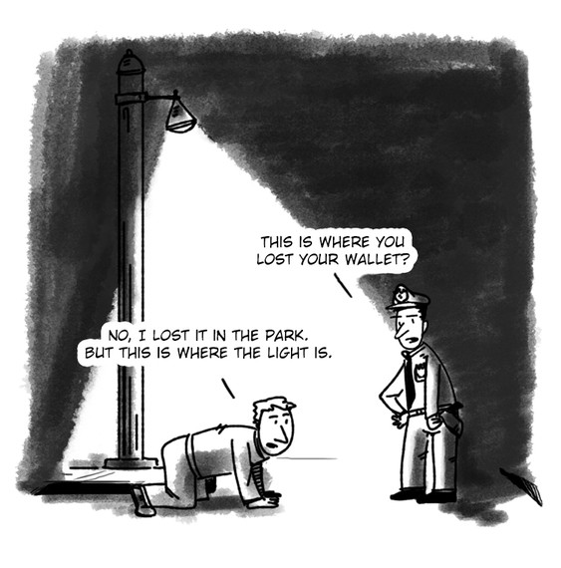
Streetlight Effect
A policeman sees a drunk man searching for something under a streetlight and asks what the drunk has lost. He says he lost his keys and they both look under the streetlight together. After a few minutes the policeman asks if he is sure he lost them here, and the drunk replies, no, and that he lost them in the park. The policeman asks why he is searching here, and the drunk replies, "this is where the light is".
Text Data
Overzealous ML Practitioners
https://en.wikipedia.org/wiki/Streetlight_effect

Slide 43
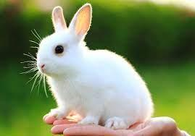
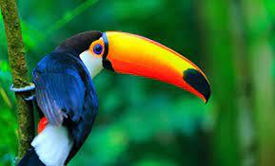
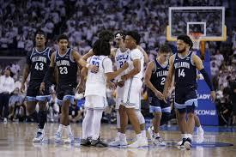
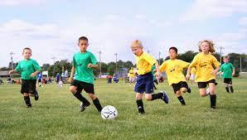

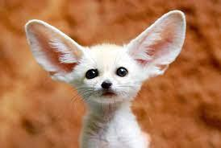
Images and Text for Retrieval
Text Query
Candidate Images
“A tropical bird perches in the jungle.”

Slide 44
Images and Text for Retrieval
Image Query
Candidate Captions
“A rabbit sits in the palm of a hand.”
“Men are talking on a basketball court.”
“A tropical bird perches in the jungle.”
“Children play soccer in a field.”
“A white fox is looking at the camera.”
“Sports equipment is staged for a photo.”

Slide 45
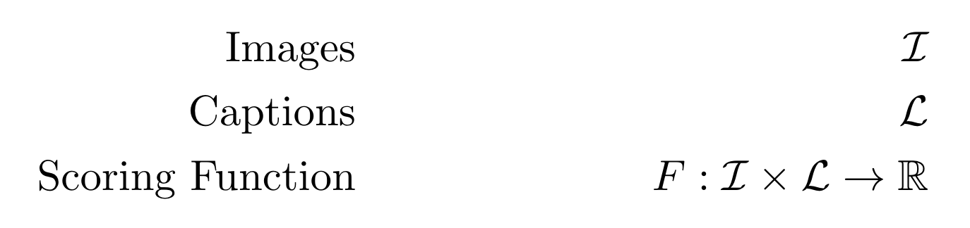
Formulating the Retrieval Problem

Slide 46
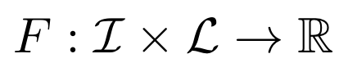
Formulating the Retrieval Problem
F(# red pixels, # word “red”) = 1 if (a > 0, b > 0) else 0
F(RGB bins, color word counts) = sum of #(color word, bin)/(#color word + #bin) in training data
F(detected objects, word counts) = sum of #(object, word)/(#object + #word) in training data
F(image pixels, token sequence) = NN trained with contrastive matching loss

Slide 47
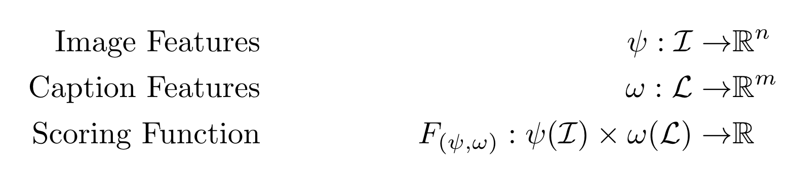
Formulating the Retrieval Problem

Slide 48
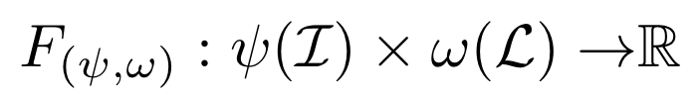
Formulating the Retrieval Problem

Slide 49
Feature Extraction for Language
“A rabbit sits in the palm of a hand.”
“A tropical bird perches in the jungle.”
“Men are talking on a basketball court.”
BOW
a
2
1
1
bird
0
1
0
hand
1
0
0
in
1
1
0
men
0
0
1
on
0
0
1
rabbit
1
0
0
the
0
1
0
…
…
…
…

Slide 50
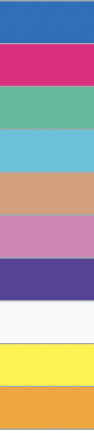
Feature Extraction for Vision
RGB
kNN bins
…
…
…
…

Slide 51
A Simple Retrieval Solution
2
0
1
1
0
0
1
…
0
…

Slide 52
Contextual Information
You shall know a word by the company it keeps (Firth, J. R. 1957:11)
You shall know the features of modality A by the company they keep in the features of modality B. And vice versa.

Slide 53
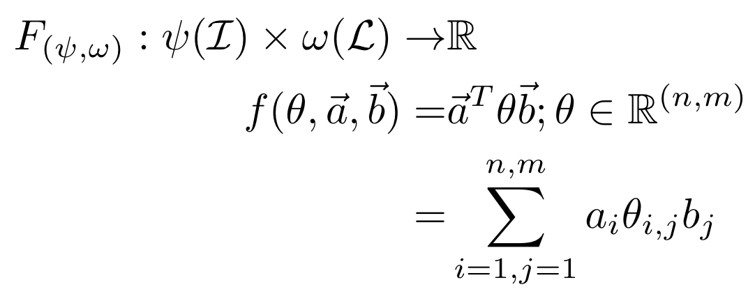
Formulating the Retrieval Problem as a Linear Model

Slide 54
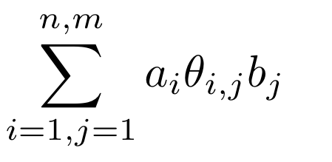
Formulating the Retrieval Problem as a Linear Model
a
bird
2
hand
0
in
1
men
1
on
0
rabbit
0
the
1
Weight of (blue, “a”)
0
Weight of (white, “bird”)

Slide 55
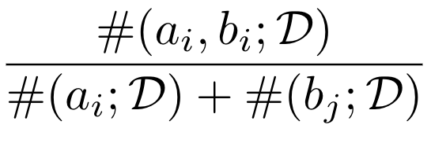
Formulating the Retrieval Problem as a Linear Model
a
bird
2
hand
0
in
1
men
1
on
0
rabbit
0
the
1
0
Times (blue, “a”) co-occurred in training data divided by sum of times blue occurred in visual training data and “a” occurred in language training data.

Slide 56
Formulating the Retrieval Problem
Feature-wise independence
Bag of Words
RGB kNN
Dataset for probability estimation.

Slide 57
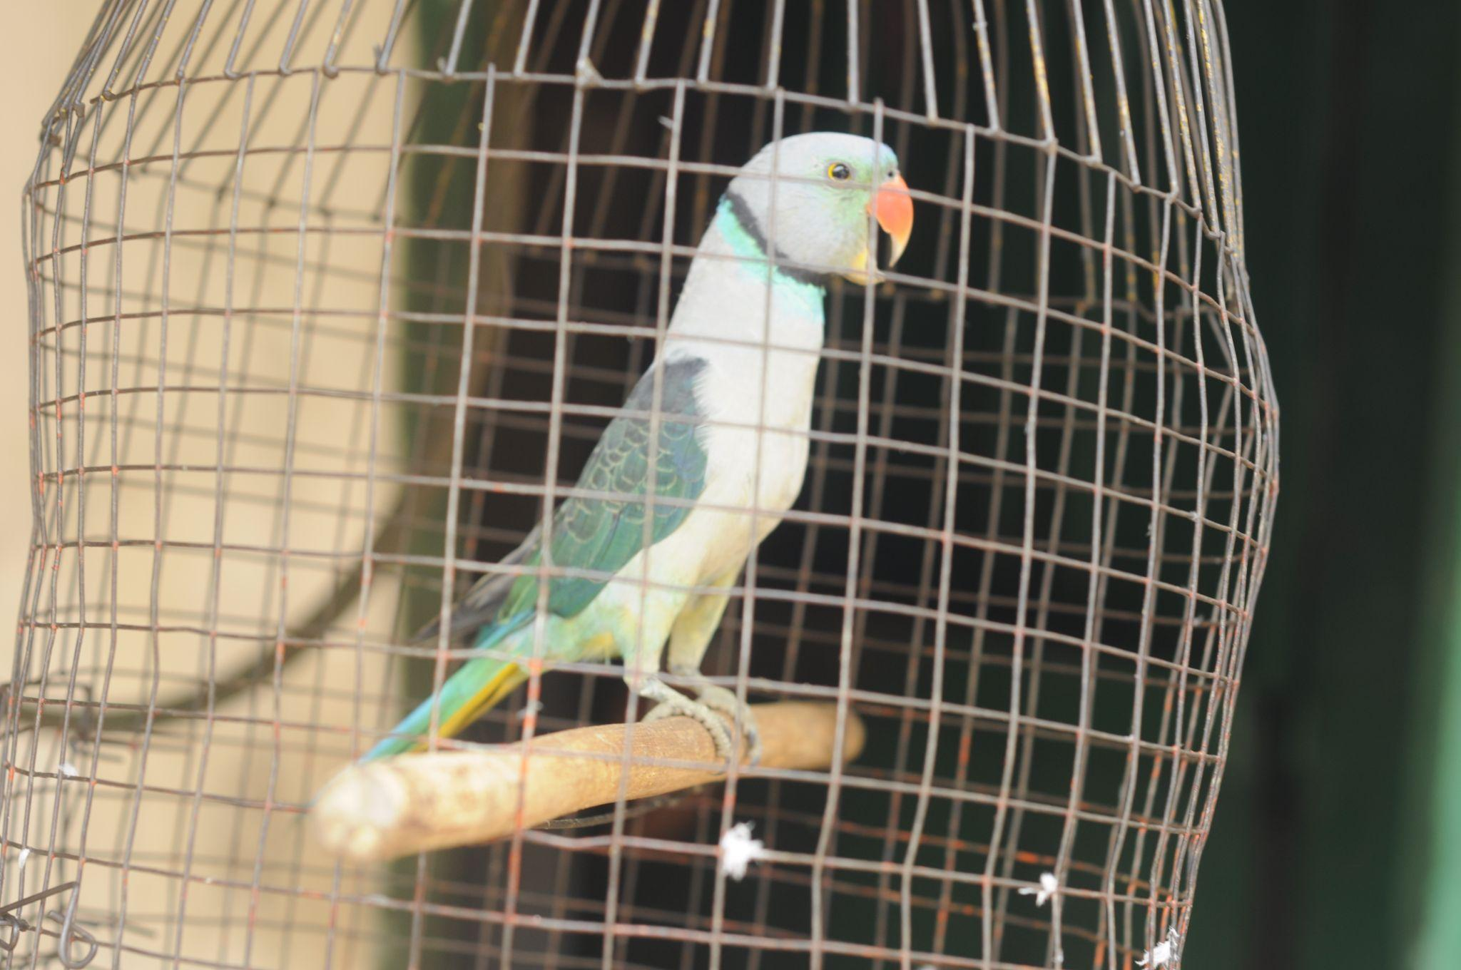
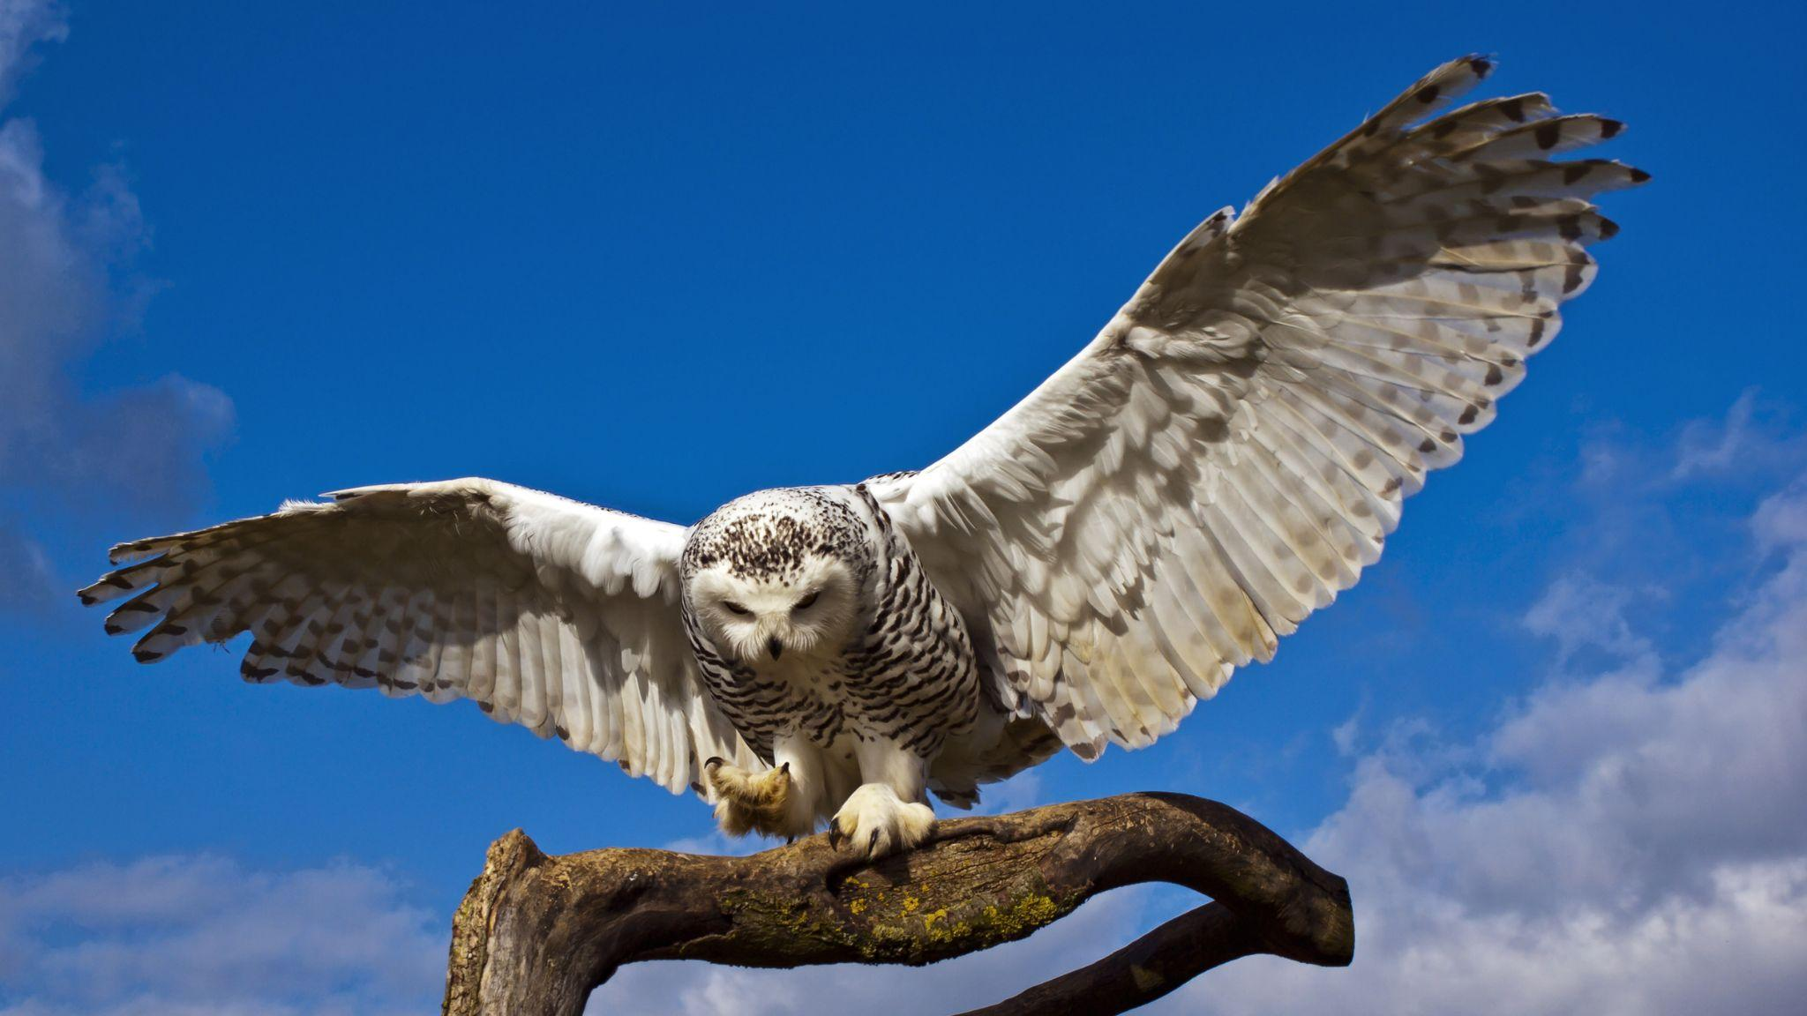
Tokenization Considering Language and Vision Retrieval
“A tropical bird perches in the jungle.”
“Perching parakeet in a wire frame cage.”
“A snow owl lands on a wooden perch.”
a
tropic
bird
perch
in
the
jungl
.
Stemming
perch
parakeet
in
a
wire
frame
cage
.
a
snow
owl
land
on
wood
perch
.

Slide 58
Tokenization Considering Language and Vision Retrieval
“A tropical bird perches in the jungle.”
“Perching parakeet in a wire frame cage.”
“A snow owl lands on a wooden perch.”
a
tropic
bird
perch
in
the
jungl
.
Stemming
perch
parakeet
in
a
wire
frame
cage
.
a
snow
owl
land
on
wood
perch
.

Slide 59
Tokenization Considering Language and Vision Retrieval
“A tropical bird perches in the jungle.”
“Perching parakeet in a wire frame cage.”
“A snow owl lands on a wooden perch.”
a
tropic
bird
perch
in
the
jungl
.
perch
parakeet
in
a
wire
frame
cage
.
a
snow
owl
land
on
wood
perch
.

Slide 60
Pretrained Language Token Embeddings
Cosine similarity of “bird”, “owl”, “parakeet” helps share information across training data
Taking a guess: what are the nearest neighbors of “green” in word2vec embedding space?
Blue, white, red, yellow, black, grey, purple, pink, light, gray
What can we learn for highly polysemous words like “play”?
“play guitar”, “play piano”, “play basketball”, “play tag”
Text-based embeddings help us share information only to the extent that words used in a similar context share a visual representation
which is true for, say, birds or trees, but not colors

Slide 61
Pretrained Language Token Embeddings
Training
Inference
“A white bunny rabbit held in a green field.”
“A black rabbit watches a red sunset.”

Slide 62
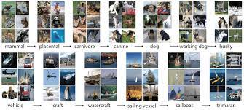
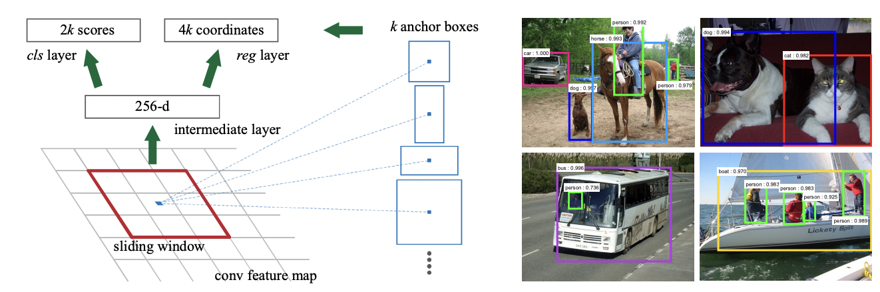
Feature Extraction for Vision
Object Classification
Object Detection
AlexNet, VGG, ResNet, …
Faster R-CNN, YOLO, …
Faster R-CNN: Towards Real-Time Object Detection with Region Proposal Networks, 2015.

Slide 63
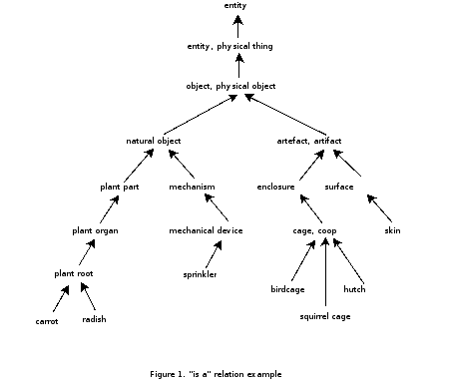
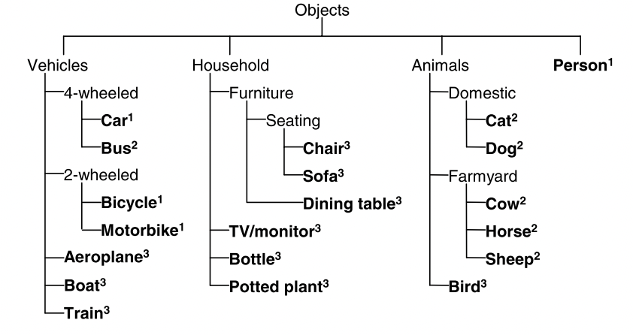
Feature Extraction for Vision
Object Classification
Object Detection
AlexNet, VGG, ResNet, …
Faster R-CNN, YOLO, …
The PASCAL Visual Object Classes (VOC) Challenge, 2010.

Slide 64
Image Feats. Considering Language and Vision Retrieval
“A tropical bird perches in the jungle.”
“Perching parakeet in a wire frame cage.”
“A snow owl lands on a wooden perch.”
toucan
Object Classification
cockatoo
great grey owl
https://deeplearning.cms.waikato.ac.nz/user-guide/class-maps/IMAGENET/

Slide 65
Image Feats. Considering Language and Vision Retrieval
“A tropical bird perches in the jungle.”
“Perching parakeet in a wire frame cage.”
“A snow owl lands on a wooden perch.”
bird
potted plant
Object Detection
bird
boat
bird
aeroplane

Slide 66
Image Feats. Considering Language and Vision Retrieval
“A tropical bird perches in the jungle.”
“Perching parakeet in a wire frame cage.”
“A snow owl lands on a wooden perch.”
bird
potted plant
a
tropic
bird
perch
in
the
jungl
.
bird
boat
perch
parakeet
in
a
wire
frame
cage
.
bird
aeroplane
a
snow
owl
land
on
wood
perch
.

Slide 67

Image Feats. Considering Language and Vision Retrieval
“A tropical bird perches in the jungle.”
“Perching parakeet in a wire frame cage.”
“A snow owl lands on a wooden perch.”
bird
potted plant
a
tropic
bird
perch
in
the
jungl
.
bird
boat
perch
parakeet
in
a
wire
frame
cage
.
bird
aeroplane
a
snow
owl
land
on
wood
perch
.

Slide 68
Mitigating Issues With Image Feat. Extraction
CNNs trained on object classification
Penultimate layer as a feature vector
CNNs trained to do object detection
Local penultimate feature reps of each bounding box
Patch-based alternatives for transformers
Learn transformations of small image patches as “embeddings” for a transformer.
Learning without labels: directly align caption and images

Slide 69
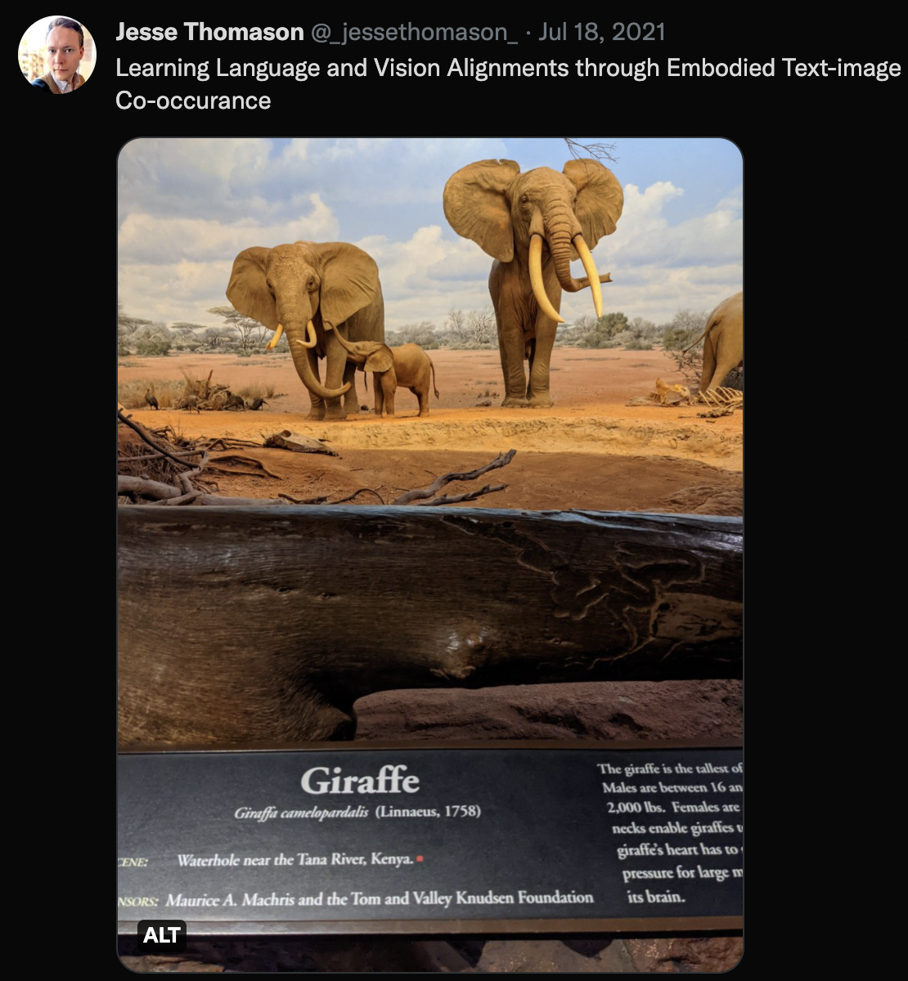
What We Glossed Over
There are many non-neural ways to extract powerful language and vision features that span decades of work
POS, fast point feature histograms, lemmatization, …
How can we build PMI into loss functions for ML?
Hinge losses; contrastive losses
Co-occurrence isn’t ground truth

Slide 70
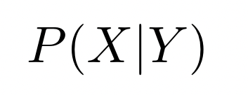
Conditional Discriminative Models for Retrieval (ImSearch)
Training Data
“A rabbit sits in the palm of a hand.”
Maximize the probability of the image X given the caption Y in the training data.
Example: for each training caption, batch it with true image and distractor images, then use cross entropy.
“A white fox is looking at the camera.”
“Children play soccer in a field.”
“Men are talking on a basketball court.”

Slide 71
Conditional Discriminative Models for Retrieval (ImSearch)
“A rabbit sits in the palm of a hand.”
Shuffle these, or else?
Some text-processing neural network
Some image-processing neural network
Learned Scoring Network
Cross Entropy Loss
Some image-processing neural network
Learned Scoring Network
Softmax
Some image-processing neural network
Learned Scoring Network

Slide 72

Conditional Discriminative Models for Retrieval (ImSearch)
Training Data
“A rabbit sits in the palm of a hand.”
Are these expressions symmetric?
P(X|Y) learn which words indicate which visual features.
P(Y|X) learn which visual features indicate which words.
Iff symmetric, P(a|b)=P(b|a) for all a,b
“A white fox is looking at the camera.”
“Children play soccer in a field.”
“Men are talking on a basketball court.”

Slide 73

Conditional Discriminative Models for Retrieval
Training Data
dog
“terrier”
dog
“husky”
“play”
guitar
guitar
“play”
guitar
“play”
frisbee
“play”
frisbee
P(guitar|”play”)=0.5
P(“play”|guitar)=1
…*P(“play”)=0.25
…*P(guitar)=.25

Slide 74
Estimating Joint Distributions

Slide 75
Estimating Joint Distributions
Define F as cosine similarity between image and caption embeddings
Then we can learn:
(minimally) a projection network that maps image embeddings and caption embeddings to the same space
(bonus) an image feature extractor (psi)
(bonus) a language feature extractor (omega)

Slide 76
“A rabbit sits in the palm of a hand.”
“Children play soccer in a field.”
“A white fox is looking at the camera.”
“Men are talking on a basketball court.”
Image Embedder
Caption Embedder
Pull matching image/caption embeddings together.
Push distractor image/caption embeddings apart.
L
L
I
I
L
Learned Projection
Learned Projection
I
L
I

Slide 77

Contrastive Language–Image Pre-training (CLIP)
https://openai.com/blog/clip/

Slide 78



Language and Vision: Regions
Word attentions H_{w} as keys/values for image queries
Region attentions H_{V} as keys/values for language queries
ViLBERT: Pretraining Task-Agnostic Visiolinguistic Representations for Vision-and-Language Tasks

Slide 79

Language and Vision: Regions
a
bird
2
hand
0
in
1
Training outputs to have high cosine similarity is the same core idea as our lil linear model
men
1
on
0
rabbit
0
the
1
0
ViLBERT: Pretraining Task-Agnostic Visiolinguistic Representations for Vision-and-Language Tasks

Slide 80

Transformers for Vision: Patches
Learned positional embeddings! :o
An Image is Worth 16x16 Words: Transformers for Image Recognition at Scale

Slide 81

Language and Vision: Patches
ViLT: Vision-and-Language Transformer Without Convolution or Region Supervision

Slide 82

Contrastive Language–Image Pre-training (CLIP)
BPE Tokens into Transformer
Patch-based ViT
Maximize match
https://openai.com/blog/clip/

Slide 83




Multi-task Multi-modal Model: Unified IO
https://unified-io.allenai.org/

Slide 84

Multi-task Multi-modal Model: GPT-4
Algorithm details?
No one will ever know.
Since CLIP, OpenAI has committed to making deeply scientifically uninteresting AI artifacts.
https://openai.com/research/gpt-4

Slide 86
CSCI 566: Deep Learning and Its Applications
Jesse Thomason
Lecture 8: Multimodal Deep Learning

